Slide 1

What is a Computer System ?
By Aaron Mascarenhas

Slide 2
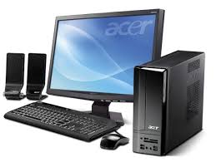
Computer System...
A Computer System consists of CPU, memory and related electronics which are connected to it and its operating system.
Components of a computer system are -
Input/Output Devices
Hardwares
Softwares
Central Processing Unit (CPU)

Slide 3
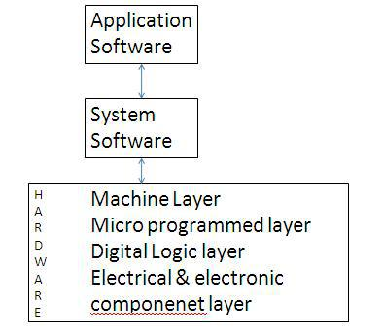
Computer Organization...
It is the operation units and their interconnection that realize architectural specification.
Hardware Level -
Electrical & electronic components layer
Digital Logic layer
MIcroprogrammed layer
Machine layer
Software Level -
System Software Layer
Application Software

Slide 4
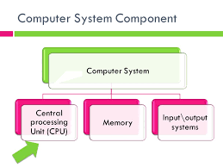
Main Subsystems and connections of a computer

Slide 5
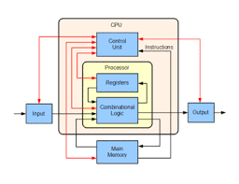
Sub-systems of Computer...
Control Unit -
It gives instructions to the processor by giving instructions to the arithmetic/logic unit and input and output devices as to what needs to be done.
ALU (Arithmetic Logic Unit) -
It performs calculations and logical operations, it also it the foundation of the CPU.
Memory or Storage Unit -
It where all the data is stores and what instructions are given for processing to the CPU.
Input/Output Devices (I/O) -
It communicates with the CPU and external sources ans with mass storage devices. (eg- USB, CD, network)

Slide 6
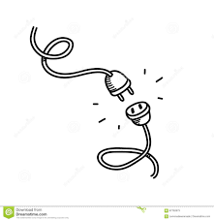
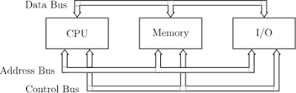
Connections of a subsystems...
Bus Structure - Electrical path between components of a computer.
Data Bus - Carries actual data, bidirectional.
Address Bus - Carries memory locations for data or instruction, unidirectional.
Control Bus - Carries timing and control functions from control unit to other units, unidirectional.

Slide 7
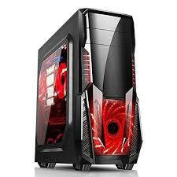
What is a CPU ?

Slide 8
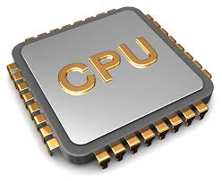
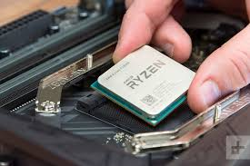
CPU...
A central processor unit, or a cpu is a the brains of a computer which performs basic set of tasks using arithmetical, logical, input/output operations.
It is the main computer case containing the central components of a personal computer.

Slide 9
CPU systems and subsystems ?

Slide 10
CPU dependency and performance with Computer systems...
Computer Systems | Dependency | Performance
Hardware | Power Supply | Low-voltage DC power for internal components
Motherboard | CPU | Integrated circuitry that connects with the computer
Hard Disk | CPU | Storing and retrieving digital information
Software | OS | Provides instructions for computer on what to do
Keyboard | Output Data | Used to input data by typing
Mouse | Output Data | Detecting 2-dimensional motion
Monitor | Input Data | Electronic visual display for computers
Speaker | Input Data | Disables the lower fidelity built-in speaker

Slide 11
CPU dependency and performance with subsystems...
Sub-Systems | Dependency | Performance
Control Unit | CPU | Directs instructions sent to the processor
ALU | Processor | Arithmetic and logic operations
Memory/Storage Unit | Hard Disks | Storing , porting and extracting data files and objects
Input/Output Devices | Hardware | Sending data from a computer

Slide 12
Summary -
Computer Systems
Computer Organization
Main sub-subsystems of a computer
Connections of a subsystems
What is a CPU
Purpose and operation of the CPU
CPU dependency and performance with regards to associated systems and subsystems

